Slide 1


RAIS(Robotics And AI Society)

Slide 2

Purpose and Need
We are entering an era where AI will diagnose, treat, and assist. Traditional computer science teaching is not aligned with how medical minds think. Customized programming education can unlock potential in Students with medical background. Students interested in AI in Healthcare, Agentic AI, and Bioinformatics should have a home to learn, discuss, and grow.
RAIS

Slide 3
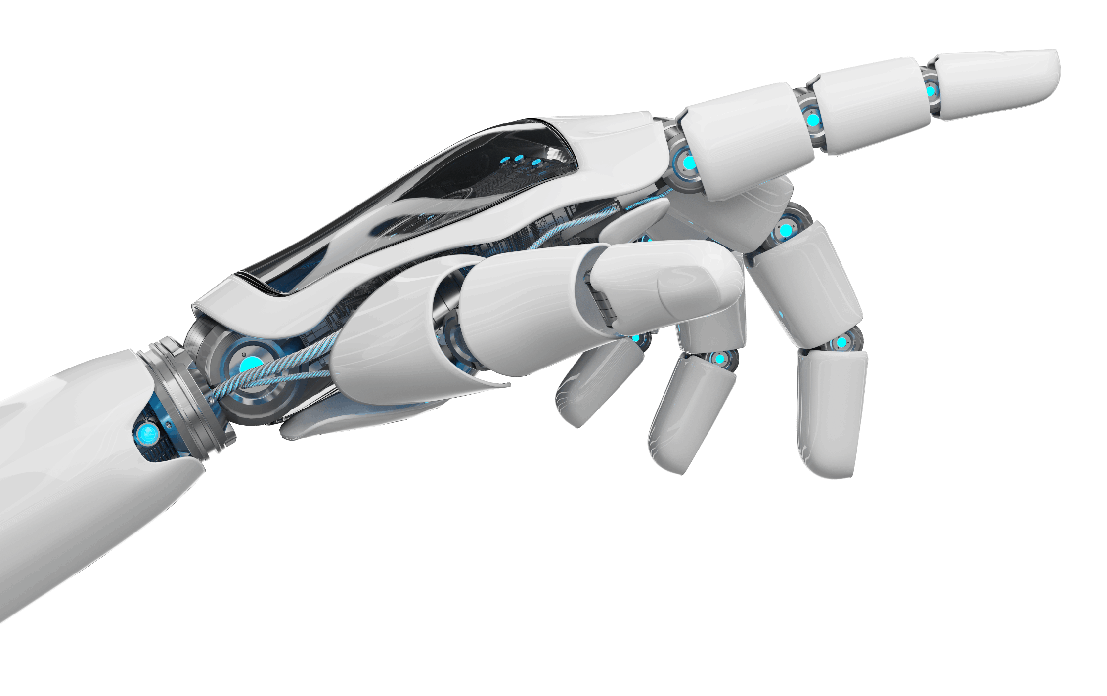
Vision of the Society
To empower CS students from medical background with programming and AI skills, bridging the gap between healthcare and technology, and preparing them for the future of driven by Artificial Intelligence and Agentic AI
RAIS

Slide 4
Society Structure
Position | Role
President | Main leader. Organizes meetings, oversees all activities, represents society to university.
General Secretary | Manages records, handles communications, schedules events.
Vice President (Academics) | Plans and monitors weekly learning sessions and workshops.
Vice President (Projects) | Organizes hands-on projects.
Event Coordinator | Arranges guest lectures, workshops, and special events.
Public Relations Officer (PRO) | Handles promotions, social media, student engagement.
Executive Members | Volunteers who help in all tasks (depending on interest/skills).

Slide 5
Membership Policy
Open
Pro
Details
Open to all department students.
No programming background needed — only passion and curiosity required.
Annual registration (Google Form + Specific details).
RAIS

Slide 6

Leadership Selection
No Politics Rule
AI and Programming basics + Leadership questions
Interview
Only committed and capable students become office-bearers.
Every year re-selection through tests.
RAIS

Slide 7
Leadership Selection
No Politics Rule — Purely based on:
AI and Programming basics + Leadership questions
Interview
Only committed and capable students become office-bearers.
Every year re-selection through tests.
RAIS

Slide 8
Activity Model
Profile
GITHUB
Post Code
Week | Activity
1 | Programming Language basics (C++/Python/TypeScript etc.)
2 | AI concepts (Intro to Machine Learning, Agentic AI)
3 | Hands-on project kickoff
4 | Students' mini-presentations
5 | Guest speaker session
6 | Fun coding competitions
Repeat | with new themes every 2 months
LINKEDIN
Post Video of Project
GITHUB CODESPACE
For Coding Purpose
RAIS

Slide 9

Engagement Model
Project-based Groups
Students grouped into teams to build mini projects.
Gamified Learning
Skill Trees
Students unlock badges as they complete milestones (like gaming).
Mentorship Program
Senior students mentor juniors.
RAIS
Notes:
Code Analyst
Pythonic Pulse Neural Novice

Slide 10

Code of Conduct
Respect everyone.
No Politics, No Bias.
Learning-focused Environment.
Help each other — we rise together.
RAIS

Slide 11

Final Call
Your suggestions are very helpful. Clarifying the criteria for leadership—such as specifying the skills or knowledge required—and explaining how commitment will be measured can help students understand what is expected.
Gemini
RAIS

